Slide 1
Practice on Chartlet Plot the First Fix
Date | RC | VH | RF |  | Depth
Time
0900 | 300yds | 154 | 1200yds |  | 18ft
Ordered Course: 126T
Ordered Speed: 6kts
Notes:
Teaching Points:
Read along the Meridian
Visual Fixes are circles
Optimal spread of LOP
When should we take another fix based on the water we are in? (NAVDORM)
After every fix we need to DR…Leads you into Dead Reckoning
Purpose
6 Rules
How to plot….leads into 3 min rule

Slide 2
Practice on Chartlet Plot the Second Fix and DR
Date | RC | VH | RF |  | Depth
Time
0900 | 300yds | 154 | 1200yds |  | 18
 | VE | VR | VI
0903 | 281 | 190 | 111 |  | 12
Ordered Course: 126T
Ordered Speed: 6kts
Notes:
Teaching Points:
Read along the Meridian
Visual Fixes are circles
Optimal spread of LOP
When should we take another fix based on the water we are in? (NAVDORM)
After every fix we need to DR…Leads you into Dead Reckoning
Purpose
6 Rules
How to plot….leads into 3 min rule

Slide 3
Practice on Chartlet Plot 3rd Fix and DR
Date | RC | VH | RF |  | Depth
Time
0900 | 300yds | 154 | 1200yds |  | 18
 | VE | VR | VI
0903 | 281 | 190 | 111 |  | 12
 |  | VQ | RF
0906 | 294 | 082 | 440 yds |  | 20
Ordered Course: 155T
Ordered Speed: 4kts

Slide 4
Practice on Chartlet Plot 4th Fix
Date | RC | VH | RF |  | Depth
Time
0900 | 300yds | 154 | 1200yds |  | 18
 | VE | VR | VI
0903 | 281 | 190 | 111 |  | 12
 |  | VQ | RF
0906 | 294 | 082 | 440 yds |  | 20
 |  |  | VH
0909 | 300 | 053 | 257 |  | 12
Ordered Course: 155T
Ordered Speed: 4kts

Slide 5
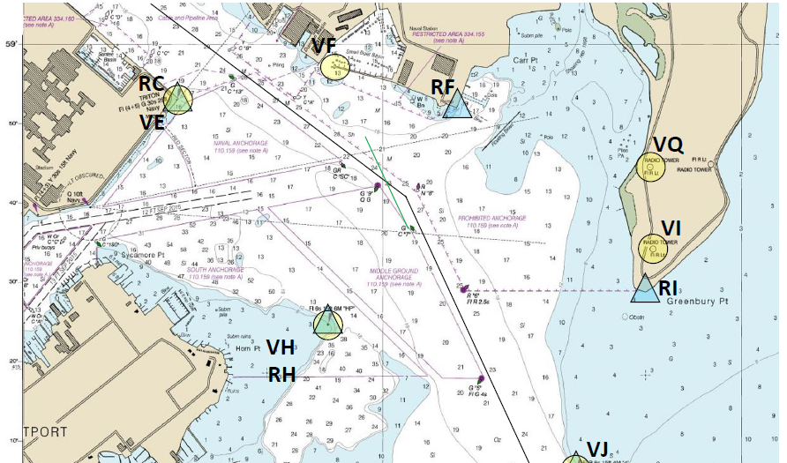
Practice on Chartlet Plot DR for the First Fix
0900
C 126
S 6
03
06

Slide 6
Practice on Chartlet Plot the Second Fix and DR
0900
C 126
S 6
0903
0903
C 126
S 6
0906
0906
0909

Slide 7
Practice on Chartlet Calculate Set and Drift for 0903 fix
0900
C 126
S 6
Set / Drift
Set: 107T
Drift: 2.5 knots
0903
0903
C 126
S 6
0906
0906
0909

Slide 8
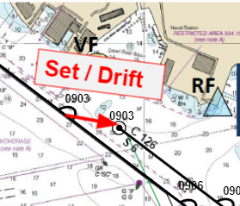
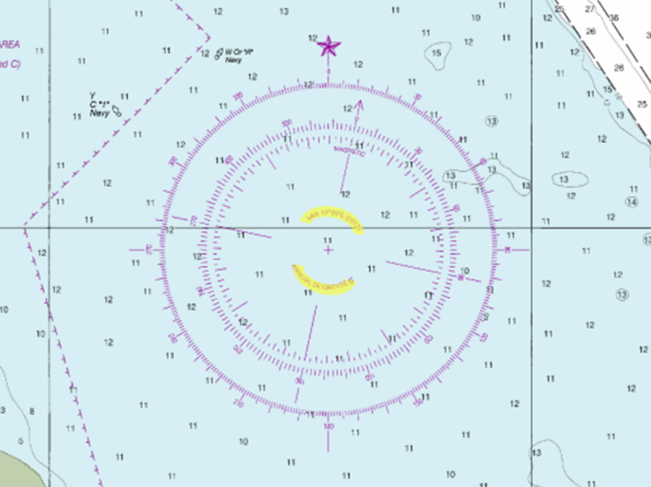
Practice on Chartlet Calculate Set and Drift for 0903 fix
90
100
110
280
270
290
180
360
180
0

Slide 9
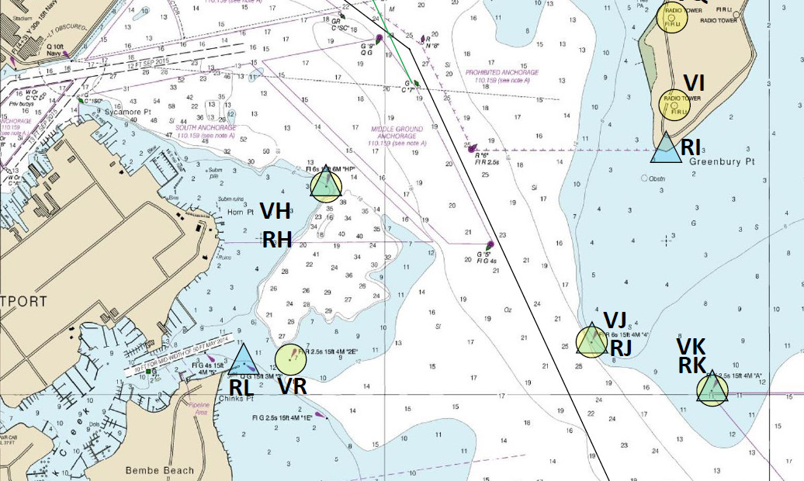
Practice on Chartlet Plot 3rd Fix and DR
0906
C-155
S- 4
Ordered Course: 155T
Ordered Speed: 4kts
0909
0912

Slide 10
Practice on Chartlet Plot 4th Fix
0906
C-155
S-4
0909
0909
C-155
S-4
0912
0912
Ordered Course: 155T
Ordered Speed: 4kts
0915

Slide 11
Practice on Chartlet Calculate Set and Drift
C-155
S -4
Set: 087 T
Drift: 2kts
0909
0909
C-155
S-4
0912
0912
0915

Slide 12
Practice on Chartlet Estimate your Position at 0912
C - 155
S - 4
0909
0909
C-155
S-4
0912
0912
0912
0915

Slide 13
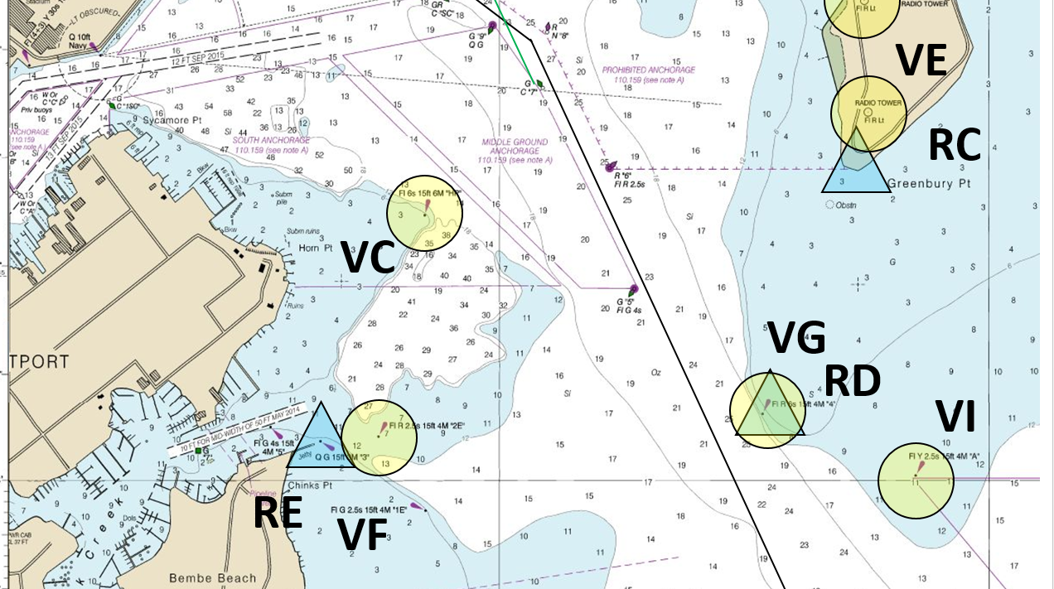
Compensating Course
What is the compensating course and speed for the 0909 fix?
175ºT / 4.1 knots
C 155
S 4
0909
Compensating Course / Speed
0909
C 155
S 4
0912
0912
0912

Slide 14
Correcting Course
What is the correcting course and speed to regain track at 0912?
Expected set / drift
194ºT / 4.2 knots
C 155
S 4
Set and Drift
0909
Correcting Course / Speed
Set: 074T
Drift: 1.4kts
0909
C 155
S 4
0912
0912
0912

Slide 15
Correcting Course
Once ordered the correcting course and speed, your ship will regain track at 0912!
C 155
S 4
194ºT / 4.2 knots
Remember, the current is still acting on your ship!!!
0909
Correcting Course / Speed
0909
C 155
S 4
0912
0912
0912

Slide 16
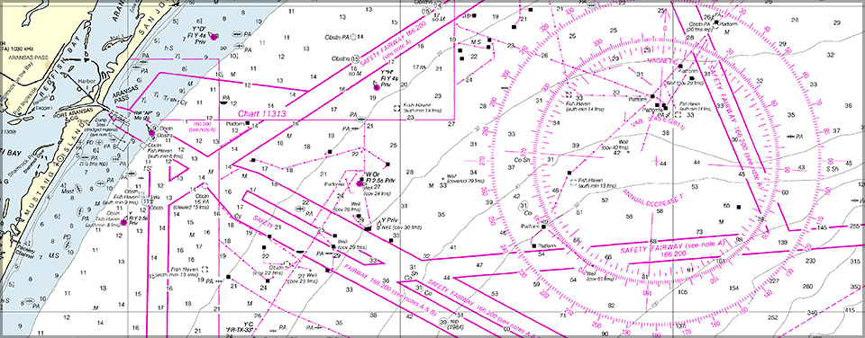

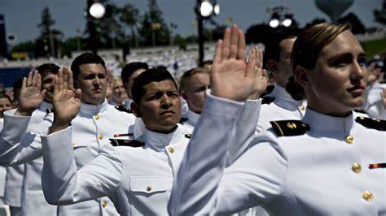
Questions?
SEANAV I United States Naval Academy
NN284 – Fundamentals of Navigation
Operations Officer I HMS PROTECTOR A173 I The Ice Patrol Ship

